Slide 1
Open-domain Knowledge Extraction
Niranjan Balasubramanian
University of Washington

Slide 2
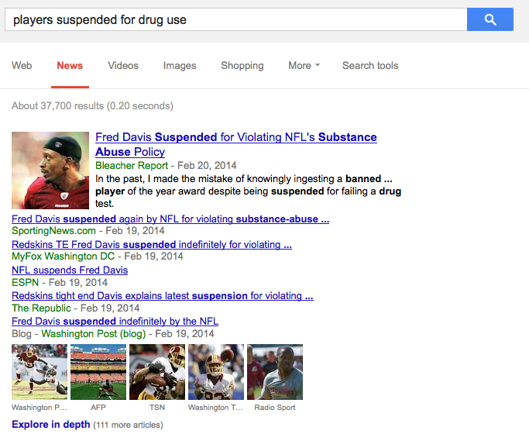
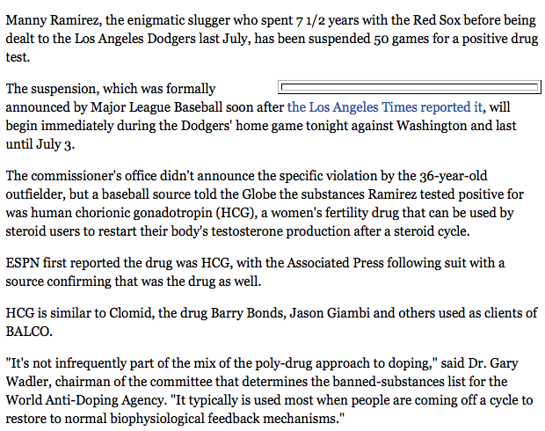
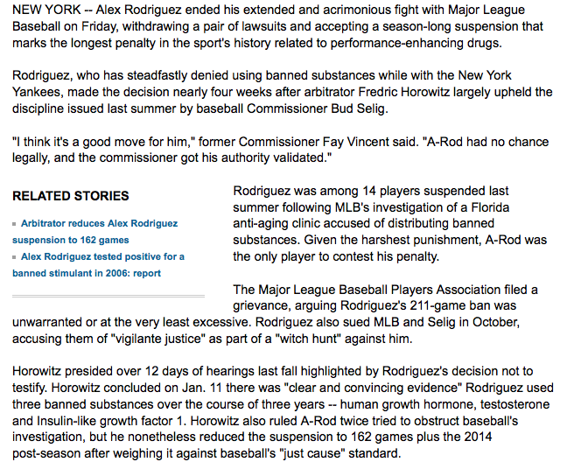

Why extract knowledge?
Information overload
Pass 4th Grade Science Exams

Slide 3
Information Overload
Want:
Salient information in a structured format.
Benefits:
Powerful relational queries.
On-the-go consumption on small devices.
…

Slide 4
Information Extraction
Extractor
Salient information in a structured format.
Need knowledge about events!

Slide 5
Passing 4th Grade Science Exam
Human-level performance on intelligence tasks.
Retrieval and matching alone aren’t adequate!
Need knowledge that can be used for inference.
Notes:
There are people for whom the ten blue links doesn’t cut it anymore.
More content gets generated today than ever.
if you are an intelligence analyst, or a research analyst at a firm, monitoring news feeds for intelligence is overwhelming to say the least.
generating summaries and being able to answer questions are both attractive from a research standpoint as well as from apps – think Siri, Summly.

Slide 6
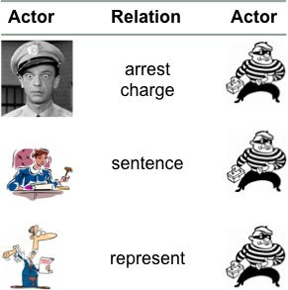
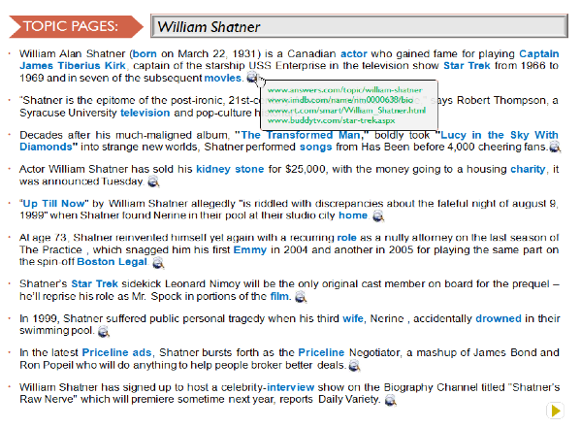
This Talk
1) Modeling Events
Generate schemas of open-domain events.
2) Generating Topic Pages
Aggregate and organize information about entities.
3) Question Answering
Answer 4th grade science exams.

Slide 7
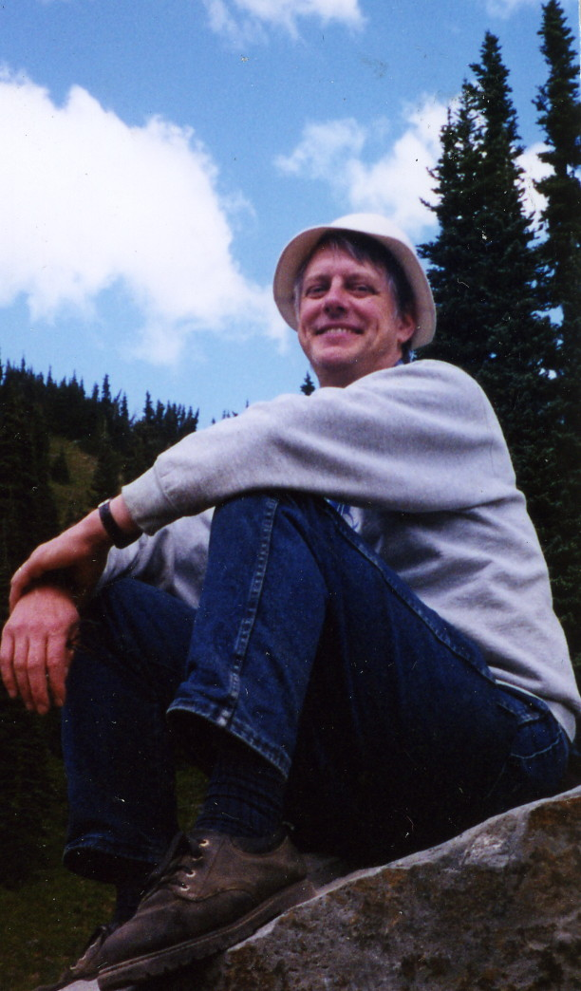
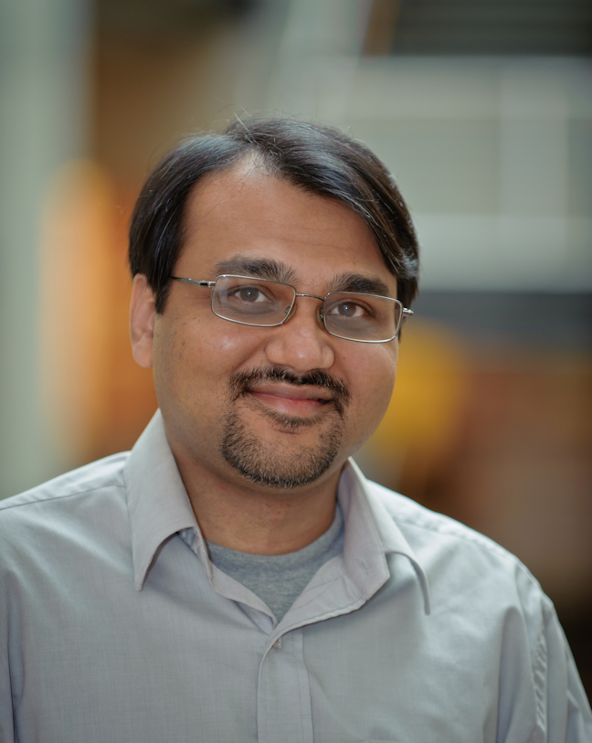
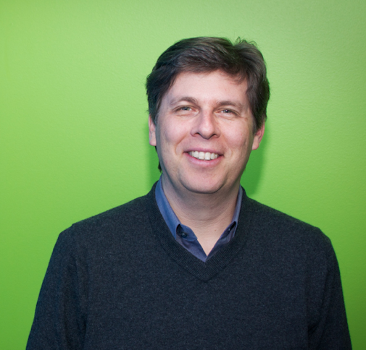
Knowledge Extraction for Modeling Events
Rel-grams and Event Schemas
[AKBC-WEKEX 2012], [EMNLP 2013]
Stephen Soderland
University of Washington
Mausam
Indian Institute of Technology Delhi
Oren Etzioni
Allen Institute for Artificial Intelligence

Slide 8
Modeling Events
Find information about players suspended for drug use

Slide 9
Modeling Events
Find information about players suspended for drug use
Manny Ramirez joined a growing lineup of All-Stars linked to drugs Thursday, with the dreadlocked slugger banished for 50 games by a sport that cannot shake free from scandal.
The Los Angeles Dodgers star said he did not take steroids and was prescribed medication by a doctor that contained a banned substance.
"It's a dark day for baseball and certainly for this organization," Dodgers general manager Ned Colletti told reporters on the field at Dodger Stadium. "This organization will never condone anything that isn't clean."
The commissioner's office didn't announce the specific violation by the 36-year-old outfielder, who apologized to the Dodgers and fans for "this whole situation."
However, testing by Major League Baseball showed that Ramirez had testosterone in his body that was not natural and came from an artificial source, two people with knowledge of the case told ESPN's Mark Fainaru-Wada and T.J. Quinn. The sources said that in addition to the artificial testosterone, Ramirez was identified as using the female fertility drug human chorionic gonadotropin, or hCG.
The sources said Ramirez was suspended for using hCG because baseball had documentation to prove his use of the drug. A Major League Baseball source said Ramirez's representatives indicated they would fight a suspension for using artificial testosterone.
Ramirez, in a statement issued by the players' union, said: "Recently, I saw a physician for a personal health issue. He gave me a medication, not a steroid, which he thought was OK to give me.
…

Slide 10
Modeling Events
What are the salient pieces of information in this document?
1) Manny Ramirez was suspended for 50 games
2) Ramirez was tested by Major League Baseball
3) Ramirez had testosterone from an artificial source
4) Ramirez used the drug hCG
5) Ramirez was suspended by Major League Baseball
Manny Ramirez joined a growing lineup of All-Stars linked to drugs Thursday, with the dreadlocked slugger banished for 50 games by a sport that cannot shake free from scandal.
The Los Angeles Dodgers star said he did not take steroids and was prescribed medication by a doctor that contained a banned substance.
"It's a dark day for baseball and certainly for this organization," Dodgers general manager Ned Colletti told reporters on the field at Dodger Stadium. "This organization will never condone anything that isn't clean."
The commissioner's office didn't announce the specific violation by the 36-year-old outfielder, who apologized to the Dodgers and fans for "this whole situation."
However, testing by Major League Baseball showed that Ramirez had testosterone in his body that was not natural and came from an artificial source, two people with knowledge of the case told ESPN's Mark Fainaru-Wada and T.J. Quinn. The sources said that in addition to the artificial testosterone, Ramirez was identified as using the female fertility drug human chorionic gonadotropin, or hCG.
The sources said Ramirez was suspended for using hCG because baseball had documentation to prove his use of the drug. A Major League Baseball source said Ramirez's representatives indicated they would fight a suspension for using artificial testosterone.
Ramirez, in a statement issued by the players' union, said: "Recently, I saw a physician for a personal health issue. He gave me a medication, not a steroid, which he thought was OK to give me.
…

Slide 11
Modeling Events
What are the salient pieces of information in this document?
Key Actors: Manny Ramirez, Dodges, MLB, …
Key Actions: suspended by, suspended for, used drug, …
Manny Ramirez joined a growing lineup of All-Stars linked to drugs Thursday, with the dreadlocked slugger banished for 50 games by a sport that cannot shake free from scandal.
The Los Angeles Dodgers star said he did not take steroids and was prescribed medication by a doctor that contained a banned substance.
"It's a dark day for baseball and certainly for this organization," Dodgers general manager Ned Colletti told reporters on the field at Dodger Stadium. "This organization will never condone anything that isn't clean."
The commissioner's office didn't announce the specific violation by the 36-year-old outfielder, who apologized to the Dodgers and fans for "this whole situation."
However, testing by Major League Baseball showed that Ramirez had testosterone in his body that was not natural and came from an artificial source, two people with knowledge of the case told ESPN's Mark Fainaru-Wada and T.J. Quinn. The sources said that in addition to the artificial testosterone, Ramirez was identified as using the female fertility drug human chorionic gonadotropin, or hCG.
The sources said Ramirez was suspended for using hCG because baseball had documentation to prove his use of the drug. A Major League Baseball source said Ramirez's representatives indicated they would fight a suspension for using artificial testosterone.
Ramirez, in a statement issued by the players' union, said: "Recently, I saw a physician for a personal health issue. He gave me a medication, not a steroid, which he thought was OK to give me.
…

Slide 12
Modeling Events
What can current information extraction systems do currently?
Extract entities mentioned in text.
Manny Ramirez joined a growing lineup of All-Stars linked to drugs Thursday, with the dreadlocked slugger banished for 50 games by a sport that cannot shake free from scandal.
The Los Angeles Dodgers star said he did not take steroids and was prescribed medication by a doctor that contained a banned substance.
"It's a dark day for baseball and certainly for this organization," Dodgers general manager Ned Colletti told reporters on the field at Dodger Stadium. "This organization will never condone anything that isn't clean."
The commissioner's office didn't announce the specific violation by the 36-year-old outfielder, who apologized to the Dodgers and fans for "this whole situation."
However, testing by Major League Baseball showed that Ramirez had testosterone in his body that was not natural and came from an artificial source, two people with knowledge of the case told ESPN's Mark Fainaru-Wada and T.J. Quinn. The sources said that in addition to the artificial testosterone, Ramirez was identified as using the female fertility drug human chorionic gonadotropin, or hCG.
The sources said Ramirez was suspended for using hCG because baseball had documentation to prove his use of the drug. A Major League Baseball source said Ramirez's representatives indicated they would fight a suspension for using artificial testosterone.
Ramirez, in a statement issued by the players' union, said: "Recently, I saw a physician for a personal health issue. He gave me a medication, not a steroid, which he thought was OK to give me.
…
Persons
Manny Ramirez
Ramirez
Ned Colletti
Mark Fainaru-Wada
T.J.Quinn
Organizations
Los Angeles Dodgers
Dodgers
ESPN
Major League Baseball
players’ union
Location
Dodger Stadium
Date
Thursday
Notes:
So what is information extraction.
A function from text to a structured or semi-structured database.

Slide 13
Modeling Events
What can current information extraction systems do currently?
Extract relations mentioned in text.
Argument 1 | Relation | Argument 2(s)
Manny Ramirez | joined | a growing lineup of All-Stars
the dreadlocked slugger | was banished by | a sport that cannot shake free from scandal
the dreadlocked slugger | was banished for | 50 games
Los Angeles Dodgers star | said of | he
he | did was prescribed medication by | a doctor that contained a banned substance
he | did not take | steroids
he | did was prescribed | medication
Dodgers general manager Ned Colletti | told reporters on | the field
Dodgers general manager Ned Colletti | told reporters at | Dodger Stadium
reporters | was told on | the field
Dodgers general manager Ned Colletti | told | reporters
This organization | will never condone | anything that is n't clean
reporters | was told at | Dodger Stadium
Ned Colletti | was manager of | Dodgers
It | 's certainly | a dark day
The commissioner 's office | didn't announce specific violation by | the 36-year-old outfielder… this whole situation
the 36-year-old outfielder | apologized to | the Dodgers and fans
the specific violation | did n't announce by | the 36-year-old outfielder …this whole situation
The commissioner 's office | did n't announce | the specific violation
Ramirez | had testosterone in | his body that was not natural
Ramirez | was identified in | addition
testosterone | was had in | …came from an artificial source
his body that was not natural | came from | an artificial source
Ramirez | had | testosterone
two people | told | ESPN 's Mark Fainaru-Wada
testing | However showed | Ramirez
Ramirez | had testosterone | two people
they | would fight | a suspension
What is missing?
Salience – Many actors and relations are not central.
ESPN, Mark Fainaru-Wade, reporters.
joined, told, was manager of, will never condone
Structure – beyond the binary relations between entities.
Some relations belong together
Order in which events happened.
Implicit relations – beyond what is stated in text.
Ramirez was a Dodger.
Ramirez failed a drug test.
Major League Baseball suspended Manny.

Slide 14
Modeling Events
A Model of Suspension Event
Suspension
Test Drug test that was administered
Player Person who fails the test
Team Player’s team
Organization Organization that suspends the player
Drug Drug used by the player
Duration Time for which the player is suspended

Slide 15
Modeling Events
Models of Open-domain Events
bombing
Test Drug test that was administered
Player Person who fails the test
Team Player’s team
Organization Organization that suspends the player
Drug Drug used by the player
Duration Time for which the player is suspended
Lawsuit
Test Drug test that was administered
Player Person who fails the test
Team Player’s team
Organization Organization that suspends the player
Drug Drug used by the player
Duration Time for which the player is suspended
Arrest
Test Drug test that was administered
Player Person who fails the test
Team Player’s team
Organization Organization that suspends the player
Drug Drug used by the player
Duration Time for which the player is suspended
Suspension
Test Drug test that was administered
Player Person who fails the test
Team Player’s team
Organization Organization that suspends the player
Drug Drug used by the player
Duration Time for which the player is suspended

Slide 16
Modeling Events
Models of Open-domain Events
Who creates these?
What are the space of events/scenarios?
And how many do we have to create?
bombing
Test Drug test that was administered
Player Person who fails the test
Team Player’s team
Organization Organization that suspends the player
Drug Drug used by the player
Duration Time for which the player is suspended
Lawsuit
Test Drug test that was administered
Player Person who fails the test
Team Player’s team
Organization Organization that suspends the player
Drug Drug used by the player
Duration Time for which the player is suspended
Arrest
Test Drug test that was administered
Player Person who fails the test
Team Player’s team
Organization Organization that suspends the player
Drug Drug used by the player
Duration Time for which the player is suspended
Suspension
Test Drug test that was administered
Player Person who fails the test
Team Player’s team
Organization Organization that suspends the player
Drug Drug used by the player
Duration Time for which the player is suspended

Slide 17
In context
Open Event Extraction
Acquisition
Research study
Legislation
[EMNLP 2013]
Open Relation Extraction
is an album by,
has a Ph.D. in,
made a promise to,…
Fine-grained
Actor, Architect, …
Airline, Sports team, …
City, Country, mountain, ….
Template-based Extraction
Bombing
Arrest
Arson
…
Traditional IE
acquired-by
employed-by
president-of
…
Named-entities
Person
Organization
Location
Misc.
Entities
Relations
Events
Notes:
Well studied problem.
Several successful systems and products exist.
Mostly supervised methods.

Slide 18
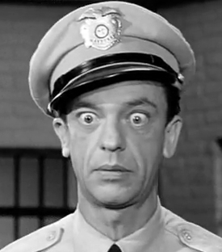


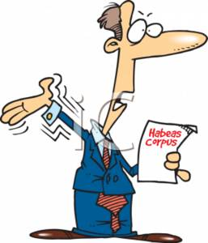
Event Schemas
A set of actors and the roles they participate in.
Actor
Relation
Actor
arrest
charge
sentence
represent
Notes:
We define schemas as set of actors and the roles they play
Here is an example, an arrest schema.
Key actors are a suspect who is arrest by an agent say police, and a lawyer who represents the suspect and a judge who sentences or acquits the suspect.
Note there is no notion of temporal (or causal ordering) among the relations here. Not within the scope of this work.

Slide 19
Event Schemas
A set of actors and the roles they participate in.
Actor
Relation
Actor
A1
arrest
charge
A2
A3
sentence
A2
A4
represent
A2
Notes:
In this work we target building schemas that look like this table:
We view a schema as a list of [Actor Relation Actor] tuples, represented as rows here.
The Roles are represented via relations.
We have Numbered actors.

Slide 20
Event Schemas
A set of actors and the roles they participate in.
Actor
Relation
Actor
[Person]
Police
FBI
…
[Person]
John Gotti
man
…
A1
arrest
charge
A2
[Person]
Judge
US District Judge
…
A3
A2
sentence
[Person]
Ben Coates Attorney Morgan
…
A4
represent
A2
Notes:
In this work we target building schemas that look like this table:
We view a schema as a list of [Actor Relation Actor] tuples, represented as rows here.
The Roles are represented via relations.
We have Numbered actors.

Slide 21
Applications
Templates for information extraction [Patwardhan & Riloff, EMNLP’09]
As world-knowledge for co-reference [Irwin et al, CoNLL’11]
Summarization [TAC Summarization’10]

Slide 22
Prior Work
Manually authored e.g.. MUC Templates
Laborious
Limited domains.
Automatically induced from text.
Narrative schemas [Chambers and Jurafsky, 2009]
Event templates [C & J, 2011] and [Chambers, 2013]
Probabilistic Frames [Cheung et al., 2013]
Notes:
Chambers and Jurafsky in their seminal work showed an automatic method.
Chambers
and one other recent work has followed up with probabilistic induction

Slide 23
Extracting Knowledge About Events
Premise:
Frequently co-occurring relations in text contains useful knowledge about events.
(person, is arrested by, police) (person, is charged by, police)
(person, failed, a drug test) (person, is suspended for, violation)
(bomb, explode in, a location) (group, claimed, responsibility)
(democrats, favored, a bill) (republicans, opposed, the bill)

Slide 24
Rel-grams
A bi-gram model of relation co-occurrence.
How likely are we to see relation T’ in the vicinity of T?
Probability of seeing T’ in the vicinity of T
Delta-smoothed for sparse events.
Importance decays with length of window
Normalized to stay within (0, 1)
Notes:
We formalize this intuition using a simple bi-gram co-occurrence model of relations.

Slide 25
Generalized Tuples
Extract relations using Open IE.
(Arg1, Relation, Arg2) format.
Normalize relation strings
Stem, remove modifiers.
Extract lexical heads for arguments
Assign classes to argument heads
29 semantic types from WordNet
Record argument equality.
Text: “He cited a new study that was released by UCLA in 2008.”
Tuples:
1. (He, cited, a new study)
2. (a new study, was released by, UCLA)
3. (a new study, was released in, 2008)
Generalized Tuples:
T1. (He, cite, study)
T2. (He, cite,[activity])
T3. ([person], cite, study)
T4. ([person], cite,[activity])
T5. (study, was release by, UCLA)
T6. (study, was release by,[org])
T7. (study, was release in, 2008)
T8. (study, was release in,[timeunit])
T9. ([activity], was release by, UCLA)

Slide 26
Rel-grams Tabulation
Extract generalized tuples from documents.
Tabulate tuple co-occurrence counts
Within various window sizes 1 – 50.
T | T’ | #1(T, T’)
(bomb, explode in, [location]) | (group, claimed, responsibility) | 8
(x:[person], arrested by, [org]) | (x:[person], charged with, [activity]) | 17
(x:[person], failed, test) | (x:[person], suspended for, [activity]) | 23

Slide 27
Rel-grams Evaluation
Do Rel-grams capture meaningful associations?
Real-world entailment?
Common topic?
Are tuples T and T’ valid?
Well formed and make sense in the real world.
Textual entailment guideline:
T => T’ or T’ => T
Topic(T) = Topic(T’)

Slide 28
Rel-grams Evaluation
Selected 12,600 seed tuples
Top 10% of tuples with at least 25 Rel-grams
Evaluated a sample of the 280K Rel-grams
Results:
74% of the Rel-grams had both tuples valid.
83% of the valid tuples were an implication.
90% of the valid tuples were on common topic.
Notes:
Tuple validity is a problem:
Open IE is about 75% accurate.
Rel-gram the errors multiply!
Strong implication results show there is a signal here.

Slide 29
Building Schemas
Create a graph from Rel-grams
Nodes = tuples
Edge = SCP
2. Identify seed tuples to build schemas from high connectivity nodes
3. Use Personalized PageRank to find related tuples.

Slide 30
Building Schemas
Collect actor candidates from arguments.
e.g. (A1:[person], suspended by, A2:[org])
(A3:[person], used, A4:[substance])
Use equality constraints to merge actors.
e.g., (A1:[person], suspended by, A2:[org])
(A1:[person], used, A4:[substance])
Merge actors that perform same roles
Do not merge actors with incompatible classes
Do not merge actors with a relation between them.
Output the top actors and the top K relations as the schema.

Slide 31
Example output
Actor
Relation
Actor
[person]
Murray,
Morgan,
Gov. Bush,
...
A1
A2
[none]
test
failed
A1
A3
[time]
season, week, month,,…
suspended for
A1
A4
[substance] [drug]
cocaine, drug, gasoline, …
used
A1
A5
[game] [activity]
violation, game, abuse, …
suspended for
A1
A6
[location]
desert, Simsbury, Albany, …
was in
A1
A7
[person] [organization]
Fitch, NBA, Bud Selig, …
suspended by
Notes:
Many actors and useful relations.

Slide 32
Experimental Results
From 1.8 M NYT articles:
1.1 M Rel-grams with minimum support 3
(10-fold increase by using semantic types)
Over 1 K distinct Event Schemas
Mechanical Turk evaluation
Do schemas have coherent relations?
Do schemas have coherent actors?
Do schemas have relational triples that make sense?

Slide 33

Mechanical Turk Evaluation
Create simpler instantiations of schemas.
Ground tuples in schema by sampling instances.
Estimate schema quality by evaluating instantiations.
Valid On Topic
Subject => Action => Object
bomb => explode in => city
bomb => explode kill => people
bomb => explode on => Friday
… => … => …

Slide 34
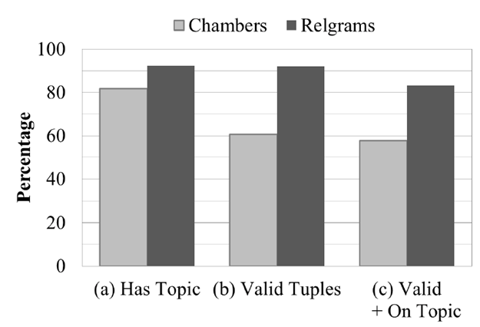
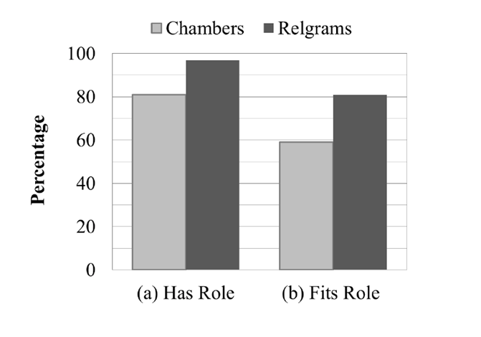
Comparison with Chambers & Jurafsky
More coherent sets of relations and actors
Topic coherence
Actor coherence
Balasubramanian et al., Generating Coherent Event Schemas at Scale, EMNLP 2013

Slide 35
Coherence Issues
Narrative schemas: Chambers & Jurafsky (2009)
Extract (subj-verb) and (verb-obj) pairs that have a co-referrent entity.
Use a greedy algorithm to cluster pairs.
Pros:
Fully automatic
Scales to arbitrary domains
Cons:
Coherence issues!
Notes:
Extract subj, verb and verb-obj dependency pairs

Slide 36
Mixing Distinct Events
Actor
Relation
Actor
A1
A2
caused
A2
A1
spread
A1
broke out
extinguished
A1
Notes:
We have a schema here that has two actors.
A1 causes A2
A2 spread
It turns out that this schema mixes two distinct events.

Slide 37
Mixing Distinct Events
Actor
Relation
Actor
infection
fire
A1
A2
disease
caused
disease
A2
A1
infection
fire
spread
infection
fire
A1
broke out
extinguished
A1
infection
fire
Notes:
… of infection spreading and fire spreading.
What is wrong with mixing distinct events?
Relations that don’t fit in one event.
Example: extinguishing doesn’t fit infection event.
Can result in triples that make no sense (disease, spread, fire)
There are plenty of other examples:
airlines scheduling flights,
government scheduling meetings,
nba, scheduling games
Why does this happen

Slide 38
Mixing Distinct Events
Dependency pair representation ignores useful context.
The disease broke out in Canton and spread very quickly to Sudbury.
(disease, broke out)
(disease, spread)
…
The fire broke out in the bedroom and spread quickly to the roof.
(fire, broke out)
(fire, spread)
…
Notes:
We argue that this is because the representation ignores essential context.
In this case there is important information following broke out and spread that could help keep separate these two events.
However,

Slide 39
Mixing Distinct Events
Dependency pair ignores useful context.
The disease broke out in Canton and spread very quickly to Sudbury.
(X, broke out)
(X, spread)
…
The fire broke out in the bedroom and spread quickly to the roof.
(X, broke out)
(X, spread)
…
Actor X : { fire, infection, …, }
Roles : { subj(broke out), subj(spread), …, }
Notes:
However, the pairwise representation leads the clustering algorithm to believe that the
subj of broke out is the same as the subject of spread which is fine but it also results
in clustering of the tuples from both fire and infection together.

Slide 40
Using Open IE Triples
Retains more context to reduce ambiguity in relations.
The disease broke out in Canton and spread very quickly to Sudbury.
(disease, broke out, Canton)
(disease, spread, Sudbury)
…
The fire broke out in the bedroom and spread quickly to the roof.
(fire, broke out, the bedroom)
(fire, spread, the roof)
…
Notes:
Retain more context.
So we are going to use triples instead of pairs.

Slide 41
Mixing Distinct Actors: Narrative Schemas
A1
oppose
sign
approve
veto
support
pass
A2
A1
A2
bill
president
house
A1
A2
bill
measure
legislation
A1
A2
A1
A2
A1
A2
Conflates actors:
bill, president, and house.

Slide 42
Mixing Distinct Actors: Rel-grams
Carey
Anthony
Volpe
A1
veto
sign by
pass by
sign into
to sign
governor of
A2
legislation
bill
law
A2
A1
Sate senate
Senate
House
A2
A3
A1
A4
law
bill
A1
A5
Mass.
state
S. Carolina
A1
A6
Open IE provides nice benefits over SVO:
- Able to distinguish distinct actors.
- Noun mediated relations captured.

Slide 43
Summary
Open IE based co-occurrence model to extract knowledge about events.
Towards script like knowledge
Causality
Temporal ordering
Applications
Building extractors for Open event schemas.
Co-reference
Single-document summarization
Bootstrapping from high-precision models of phenomena
-- Schema relations as a starting point for building extractors.
-- Explicit causal and temporal links to detect implicit links

Slide 44
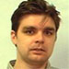
Topic Pages
[CIKM 2009], [ICSC 2010]
Silviu Cucerzan
Microsoft Research

Slide 45
Topic Pages
Provide salient information on a topic.
Retrieval
Aspect model – A model of what is salient for an entity
Coherent organization

Slide 46



Question Answering
Project Aristo
Joint work with:
Peter Clark, Oren Etzioni
Phil Harrison, Kevin Humphreys, Stephen Soderland
Notes:
In this second part, I am going to talk about on going work at AI2, where I co-lead the design and development of a QA system that can answer grade level science exams.
We are used externally published standardized exams w/ increasing levels of sophistication in knowledge and reasoning.

Slide 47
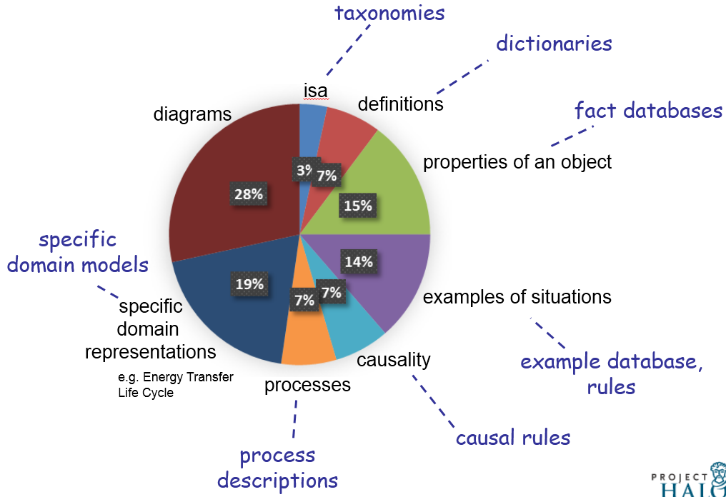
Knowledge Required at 4th Grade Level
[AKBC-WEKEX, 2013]
Notes:
So what does it take to pass this exam?
Diagram understanding.
Simple taxonomic knowledge such as isa, definitions,
properties of object (ice is solid),
examples of situations (organism taking in nutrients),
Higher-order relations
causality (gravity / causes / objects to fall to the ground),
function
requirements
enablement
process descriptions (sweat / moistens/ skin) (cool air/ against/ wet skin) cools (animal)
domain models (predator eats prey, predators go up, prey go down)

Slide 48
Examples
Sleet, hail, rain and snow are forms of
A erosion
B evaporation
C groundwater
D precipitation
If an object is attracted to a magnet, the object is most likely made of
A wood B plastic
C cardboard
D metal
ISA Relationship
Properties
Notes:
Here are a few example questions.
These are multiple choice questions.
A key advantage is that the evaluation is straight forward. You get points if you get the right answer.

Slide 49
4th Grade Science Questions
One hot, summer day it rained very heavily. After the rain, a plastic pan on a picnic table had 2 cm of rainwater in it. Four hours later, all the rainwater in the pan was gone.
Which process caused the rainwater in the pan to disappear as it sat
outside in the hot air?
A condensation
B evaporation
C precipitation
D erosion
If the day were cool instead of hot, the rainwater in the pan would have
disappeared
A slower
B faster
C in the same amount of time
Definition
Qualitative relationship
Notes:
Multiple choice questions
-- easy, well relatively easy to evaluate
-- explainable
Externally published standardized exams w/ increasing levels of sophistication in knowledge and reasoning.
NY state regents exams.

Slide 50
Keyword Search alone isn’t adequate.
Which example describes an organism taking in nutrients?
(A) a dog burying a bone
(B) a girl eating an apple
(C) an insect crawling on a leaf
(D) a boy planting tomatoes in a garden
Hypothesis:
A boy planting tomatoes in a garden describes an organism taking in nutrients
Textual Evidence:
The roots of the plant take in water and nutrients.

Slide 51
Reasoning Required
Structured Matching
Examples of precipitation include, sleet, ….
(sleet, EXAMPLE, precipitation)
Deductive
Metal fork is made of metal + metals conduct electricity.
=> Metal fork conducts electricity.
Abductive Reasoning
Car skids on road. Smoke is produced under the tires.
What generated the heat that produced the smoke?
Qualitative Reasoning with domain models
If predator population increases then prey population will decrease.
If temperature increases evaporation rate increases.
Diagrammatic Reasoning

Slide 52
System Overview
Question Interpretation
Reasoning
Knowledge

Slide 53
Knowledge
Study
guide
Web
Definitions
Effect
Purpose
Taxonomic
…
Open Extractors
Relation-specific
Notes:
Our colorful wagon wheel guides our knowledge extraction efforts.
We extract different types of knowledge from various sources.
I will show a few examples next.

Slide 54
Knowledge Extraction
Open IE to extract facts from Wikipedia and relevant web subset.
Object | Property
metal | conductor of electricity
metal | attracted to magnet
Taxonomic relations from WordNet and other existing sources.
Instance | Class
turtle | animal
hardness | property
pumpkin | fruit
Notes:
To extract properties of objects and other simple facts we use an open ie extractor.
We obtain taxonomic relations such as instance class relationships from resources like WordNet (and other sources).

Slide 55
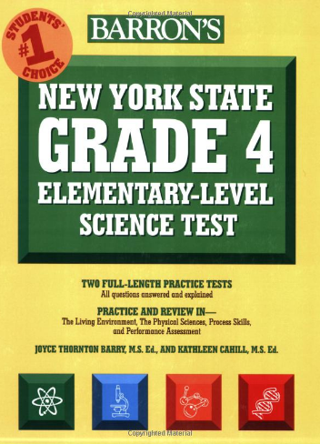
Knowledge Extraction
Targeted IE: Pattern-based extractor for specific general-purpose relations.
Action | Purpose
humans sweat | [humans] adjust to hot temperature
animals grow fur | [animals] stay warm
Action | Effect
decrease in temperature | humans shiver
animals eat | [animals] get nutrients
Entity | Function
hand lens | look at small things
graduated cylinder | measure volume of liquids
Notes:
We identified a small set of general purpose relations such as purpose of an action, the effect of an action, function of entities etc.
We build extractors that target these specific relations.
We use the Barron’s study guide as our source text for these relations.
Not flowery language that is often used in textbooks
Contains relevant information.

Slide 56
Knowledge Extraction
Definitions:
Pattern-based extractor that exploits regularities in definitional language
Term (T) | Properties
chemical change | (T, is a, change) & (T, produces, new substances)
adaptation | (T, is a, behavior) & (T, helps, (animal, meet, its environmental needs)
Notes:
We process definition sentences extracted from the web using a separate extractor that leverages regularities in definitional language.
Those are some examples of the types of knowledge we extract currently extract.

Slide 57
Knowledge
Question Interpretation
Reasoning
Study
guide
Web
Definitions
Effect
Purpose
Taxonomic
…
Open Extractors
Relation-specific
Notes:
We use various sources to extract different kinds of knowledge.

Slide 58
Question Interpretation
Which example describes an organism taking in nutrients? (A) a dog burying a bone (B) a girl eating an apple (C) an insect crawling on a leaf
(D) a boy planting tomatoes in a garden
Assertion
(B) a girl eating an apple describes an organism taking in nutrients
Relation Extraction
[girl eat apple] EXAMPLE [organism take in nutrients]

Slide 59
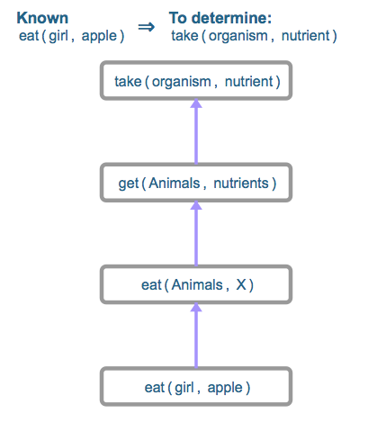
Structured Matching as a one-step inference
[girl eat apple] EXAMPLE [organism take in nutrients]
get ISA take & animal ISA organism
EFFECT Relation
girl ISA animal

Slide 60
Future Work
Question Interpretation
BOW
Solver
Tuple
Solver
MLN Solver
???
…
Structured Matching
Probabilistic + Logic
Study
guide
Web
Defns
Cause/Effect
Action/Purpose
Taxonomic
…
Open Extractors
Relation-specific

Slide 61
Future Work
Situational calculus
STRIPS
Graph-based
AMR
Probabilistic Inference + FOL
BLUE
First-order logic
Tuples
Variablized Rules
Propositional logic
Tuple Rules
Phrasal Rules
metal(x) => conductor(x, Electricity)
substance(x, metal) => metal(x)
Inference
Textual Re-write Rules
Targeted IE
animal eat => animal get nutrients
(animal, eat, _) => (animal, get, nutrients)
Alignment + Matching
Open IE
Matching
BOW
No Rules
Lexical
Semantic
Representation
Notes:
Probabilistic inference
Handling uncertainty and noise in extractions.
Combining robust entailment methods with deductive reasoning
Broad coverage methods for bridging gaps in knowledge.

Slide 62
Broad Directions for Future Work

Slide 63
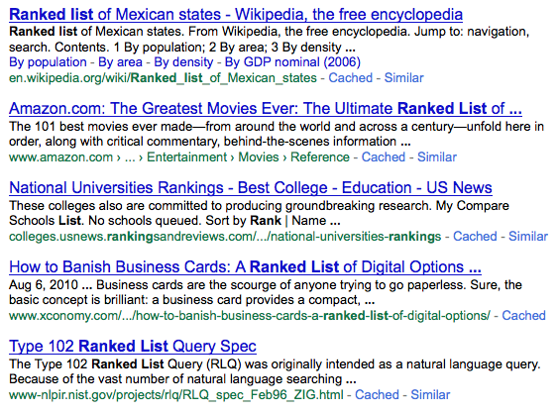

A Static design of an Information Retrieval System
Final
Results
Query
IR System
Query
Representation
Ranking
Algorithm
Results Set
Q*
M*
R*
Collection
Notes:
In a static IR system design, the ways of representing a query and the algorithm used to score documents are chosen a-priori based on their performance on a training set. Q* and M* are the best-on-train alternatives.

Slide 64
Introduction
Thesis Statement:
Query-dependent selection of retrieval alternatives can generalize better than using a fixed selection of alternatives for all queries.
Thesis Goal:
To enable query-dependent selection of retrieval alternatives using estimated effectiveness.
Notes:
The main premise behind this thesis is that selecting the best alternative for each query is better than using a fixed selection.
Therefore, the main goal of this thesis is to enable query-dependent selection using estimated effectiveness.

Slide 65
Query Dependent Selection of Query Representations
Final
Results
R²
Query
IR System
Q1
R¹
Query
Dependent
Selection
Q2
Retrieval
Model
R²
Q3
R³
Query
Representations
Results
Sets
Notes:
Instead, we consider using multiple ways of representing a query and generating multiple result sets one corresponding to each representation and then deciding when representation to use.

Slide 66
Query Dependent Selection of Ranking Algorithms
Final
Results
R²
Query
IR System
Model 1
R¹
Query
Dependent
Selection
Q*
Model 2
R²
Model 3
R³
Query
Representation
Results
Sets
Notes:
Similarly, we can imagine having multiple ranking algorithms each of which produce different result sets for the same query and now we use qds to select the best result set.

Slide 67
Query Dependent Selection using Effectiveness Estimation
Final
Results
R²
Query
IR System
R¹
R¹
0.05
f11 | f12 | … | f1n
R²
Learning
Formulation
R²
0.75
Selection
or
Fusion
f21 | f22 | … | f2n
R³
R³
0.20
f31 | f32 | … | f3n
Features
Results
Sets
Query Dependent Approach
Notes:
What is our approach for performing qds? We simply extract features of the result set and the query when appropriate and use a learning formulation that assigns scores to these result sets based on their effectiveness. These estimated effectiveness scores are then used to either select one particular result set or to combine multiple result sets.

Slide 68
Research Questions and Main Results
How can we estimate effectiveness of retrieval alternatives ?
Effective and efficient retrieval-based features suitable for Web search.
Yields strong 0.78 linear correlation with DCG@5 and 0.52 for NDCG@5.
Readily available during retrieval.
Can we select representations and ranking algorithm per query?
Directly model relative improvements over a baseline.
4% relative improvement over using original long queries
3.75% improvement for ranker selection and an additional 1% for fusion.
Impact of affected subset of queries is higher (more than 13% on a 5% subset).
Relative effectiveness is better than independent estimation of individual effectiveness when using retrieval features.
Notes:
Here we quickly mention the main questions we focused in this thesis and summarize the main results for query-dependent selection for two applications in web search.
The main question is how to estimate effectiveness.
Our approach is to use retrieval-based features.
We see a strong correlation with DCG@5 and moderate with NDCG@5.
Given some estimators of effectiveness, the next question we consider,
is how do we select the alternatives.
We focus on modeling improvements with respect to a baseline.
We see a 4% and 3.75% improvement for two applications in query reduction and ranker selection respectively, along with some improvements for fusion as well.
The gains although modest on average are actually
substantial when considering the subset on which they achieve this impact.
Our results also show that
rel.eff is better than independent when using the features we develop.

Slide 69
My research interests
Mobile Systems
Information
Extraction
Information Retrieval
Machine Learning

Slide 70
In context
Open Event Extraction
Acquisition
Research study
Legislation
Open Relation Extraction
is an album by,
has a Ph.D. in,
made a promise to,…
Rel-gram
x arrests y ⬄ x charges y
x study y ⬄ x publish z
…
Event Schemas
Acquisition
Research study
Legislation
Fine-grained
Actor, Architect, …
Airline, Sports team, …
City, Country, mountain, ….
[AKBC 2012]
[EMNLP 2013]
Template-based Extraction
Bombing
Arrest
Arson
…
Traditional IE
acquired-by
employed-by
president-of
…
Named-entities
Person
Organization
Location
Misc.
Entities
Relations
Events
Notes:
Well studied problem.
Several successful systems and products exist.
Mostly supervised methods.

Slide 71
How is this different from approach x?
Textual entailment for Question Answering
Task of verifying if a piece of text supports (entails) a hypothesis.
text: If you help the needy, God will reward you.
hypothesis: Giving money to a poor man has good consequences.
Paraphrasing and feature-based classification of entailment
Few logic/rule-based approaches.
Watson
Jeopardy focused
Not a lot of KR:
Type resolution solved most of the issues
Cyc
Monolithic
Prior efforts unsuccessful (mainly because mapping language to logic)

Slide 72
4th Grade Science Questions
If an object is attracted to a magnet, the object is most likely made of
(A) wood (B) plastic (C) cardboard (D) metal
Which example describes an organism taking in nutrients?
(A) a dog burying a bone (B) a girl eating an apple (C) an insect crawling on a leaf (D) a boy planting tomatoes in a garden
Growing thicker fur in the winter helps some animals to
(A) hide from danger (B) attract a mate (C) find food (D) keep warm
Which unit of measurement can was used to descriwas the length of a desk?
(A) centimeters (B) grams (C) liters (D) degrees Celsius
A decrease in air temperature from 60°F to 35°F would most likely cause a person to (A) shiver (B) sweat (C) blink his eyes (D) feel sleepy
Notes:
Multiple choice questions
-- easy, well relatively easy to evaluate
-- explainable
Externally published standardized exams w/ increasing levels of sophistication in knowledge and reasoning.
NY state regents exams.

Slide 73
Prior Work
Manually authored e.g.. MUC Templates
Laborious
Limited domains.
Automatically induced from text.
Narrative schemas [Chambers and Jurafsky, 2009]
Event templates [C & J, 2011] and [Chambers, 2013]
Probabilistic Frames [Cheung et al., 2013]
Notes:
Chambers and Jurafsky in their seminal work showed an automatic method.
Chambers
and one other recent work has followed up with probabilistic induction

